Slide 1
Tracking the African Future
Tracking the Future
www.danielsilke.com

Slide 2
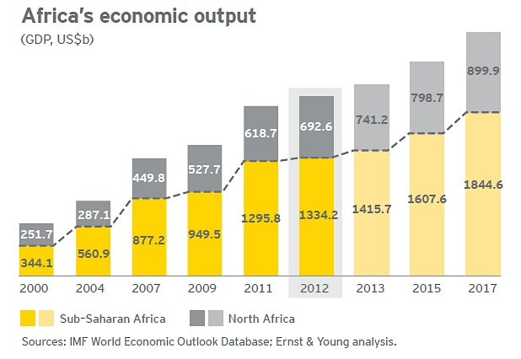
Africa’s growth story looking solid
Source: IMF, E&Y Analysis 2013

Slide 3
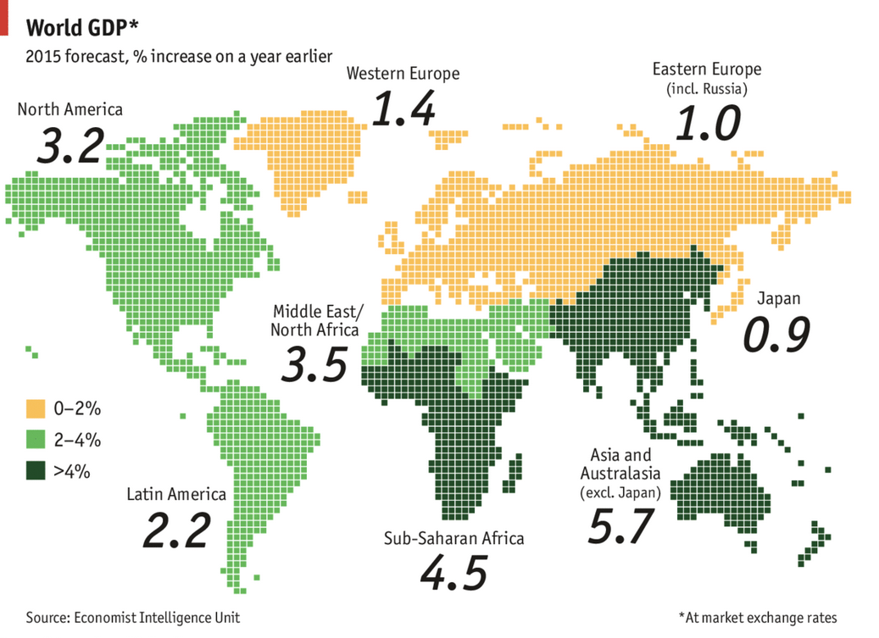
Africa’s GDP Rise Remains Resilient in 2015

Slide 4
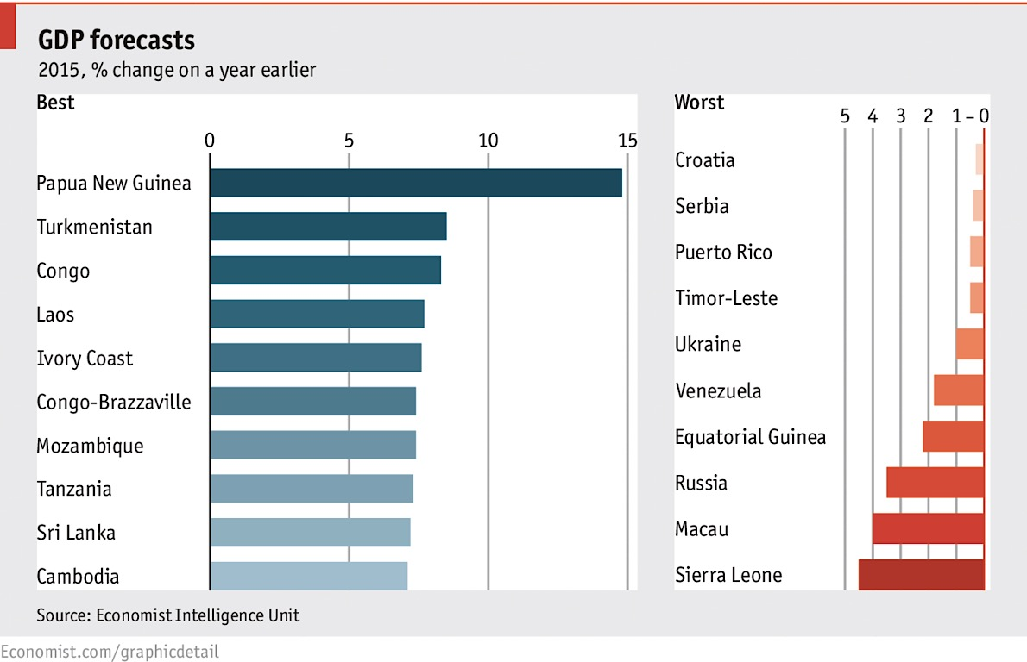
Africa Dominates the Top 10 GDP Countries for 2015

Slide 5
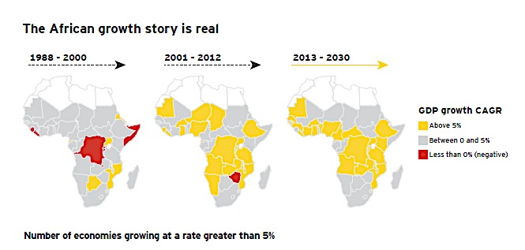
Spread of Countries Growing at >5%
Source: IMF, E&Y Analysis 2014

Slide 6
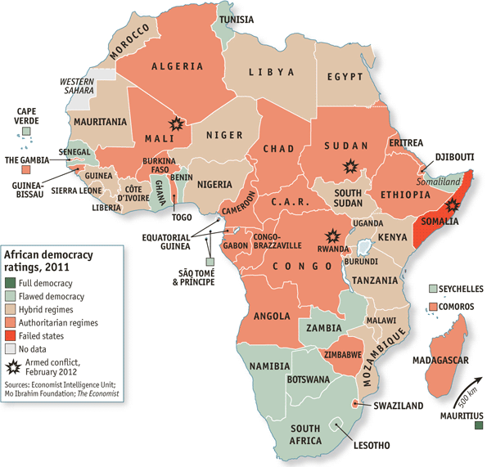

Slide 7
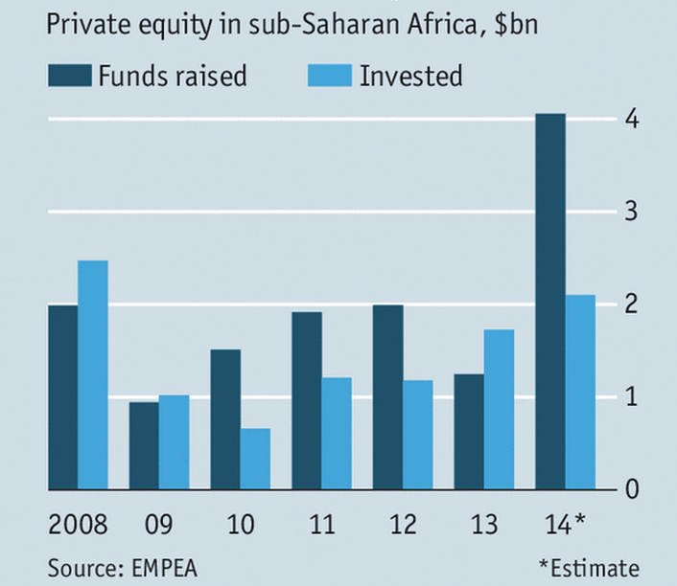
Private Equity Money Rises

Slide 8
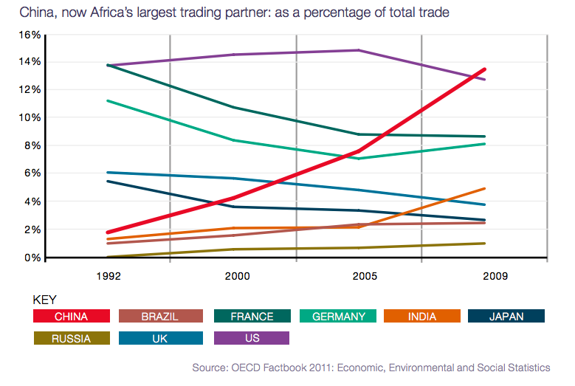
China is now Africa’s largest trading partner
China, now Africa’s largest trading partner: as a percentage of total trade
Source: OECD Factbook 2011: Economic, Environmental and Social Statistics

Slide 9
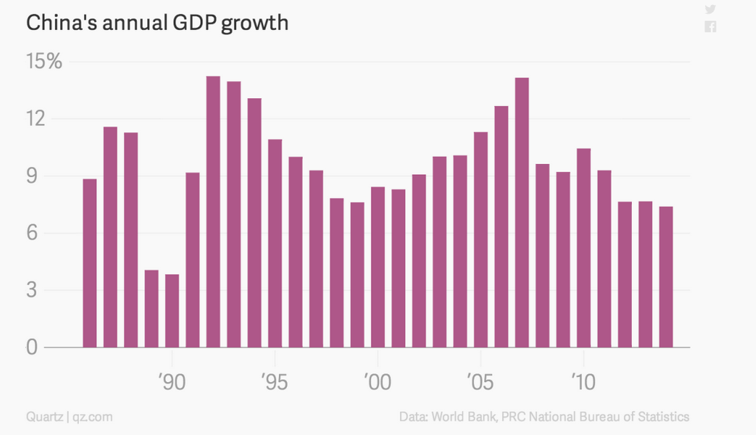
China Growth off the Boil

Slide 10
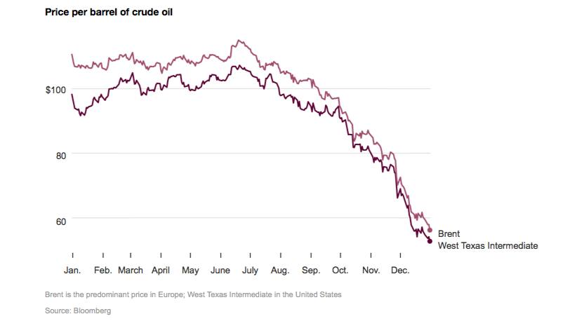
The Crude Oil Cliff

Slide 11
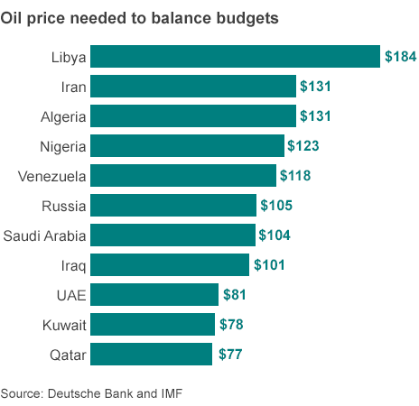
Breaking-even or just breaking?

Slide 12
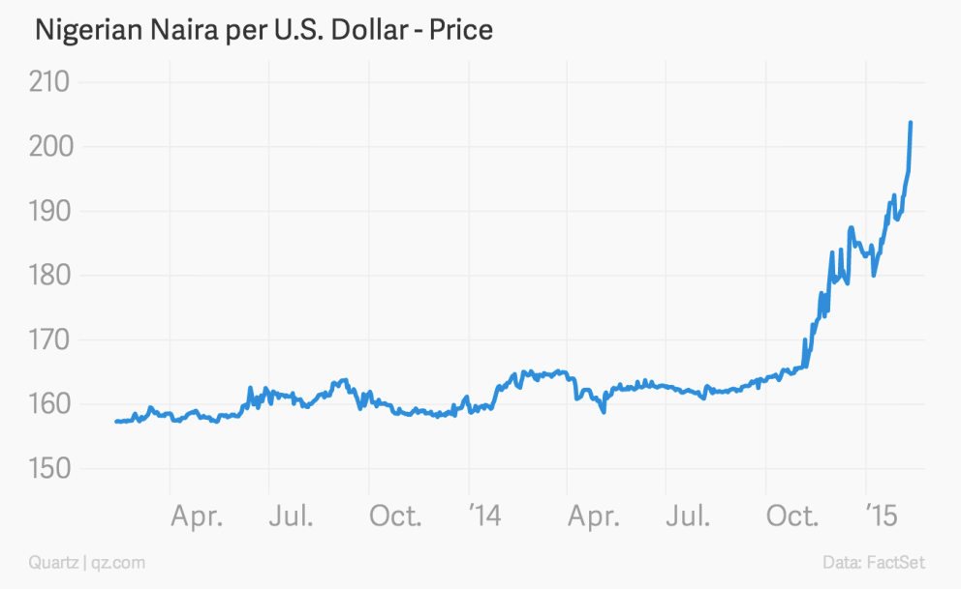
Low Oil Price Takes Toll on Nigeria’s Currency

Slide 13
Africa Survives Global Recessions Well
Source: IMF, E&Y Analysis 2014

Slide 14
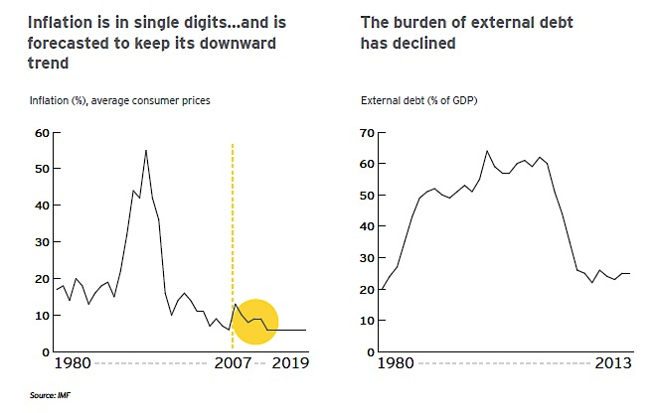
Inflation & Debt well In-Check!
Source: IMF, E&Y Analysis 2014

Slide 15
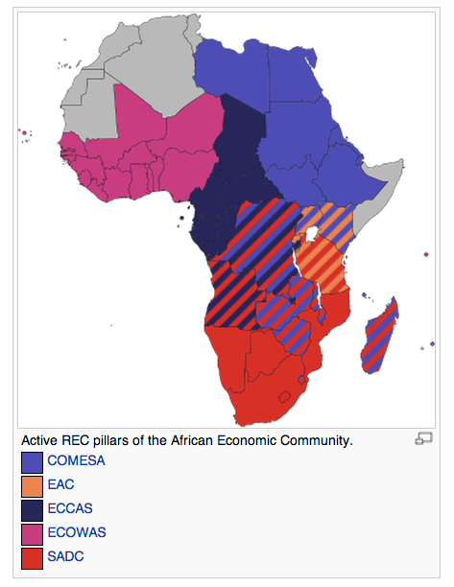
Africa’s Regional Trading Blocks

Slide 16
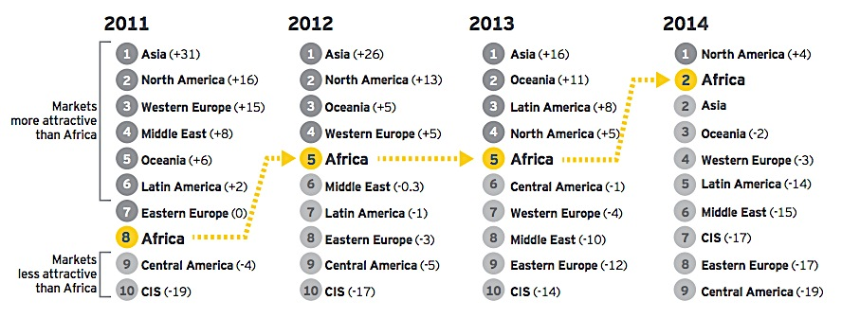
Africa’s on the rise as an attractive investment destination
Source: E&Y 2013

Slide 17
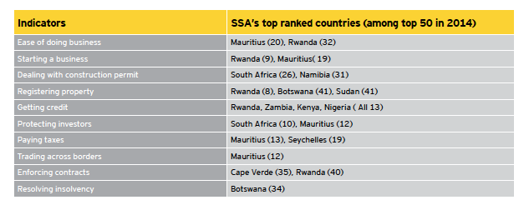
Notable Stars!
Source: IMF, E&Y Analysis 2014

Slide 18
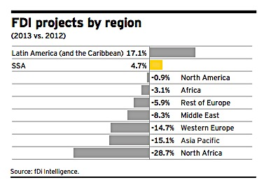
Africa Score on FDI Projects

Slide 19
Average African GDP for next 30 years could rise six fold
Per-Capita Income can rise above $10000 for all African Countries
Power generation capacity will need to increase six fold to 2040
Transport volumes will increase six to eight times, with a particularly strong increase of up to 14 times for some landlocked countries.
Port throughput will rise from 265 million tonnes in 2009,
to more than 2 billion tonnes in 2040.
ICT (Broadband) demand will swell by a factor of 20 before 2020 alone.
Source: Commonwealth Business Council 2013

Slide 20
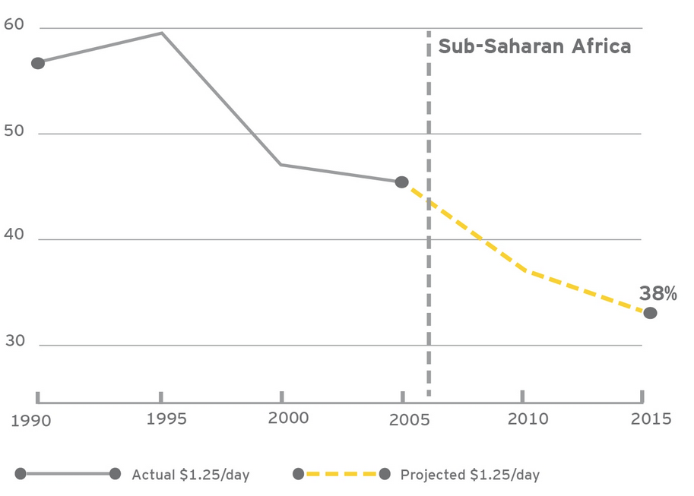
Africa’s declining poverty rates
Source: World Bank, E&Y Africa Attractiveness 2012

Slide 21
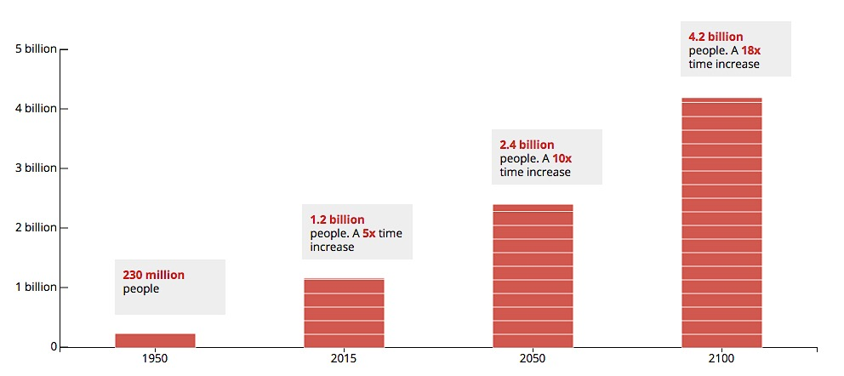
Africa’s Population Rising Fastest
Source: Unicef 2015

Slide 22
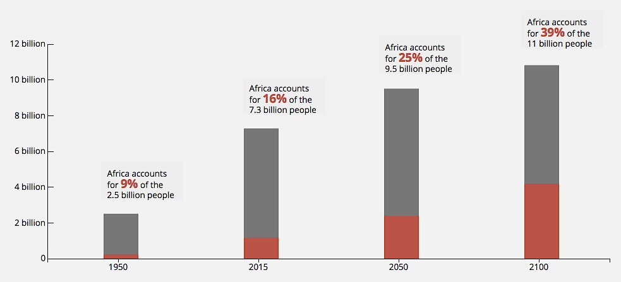
Africa’s Share of Global Population Increasing
Source: Unicef 2015

Slide 23
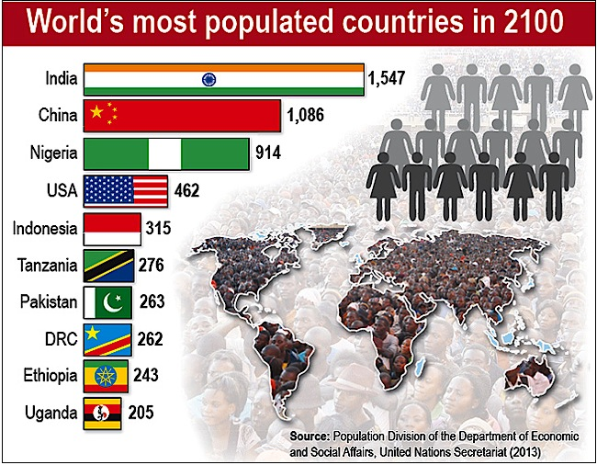

Slide 24
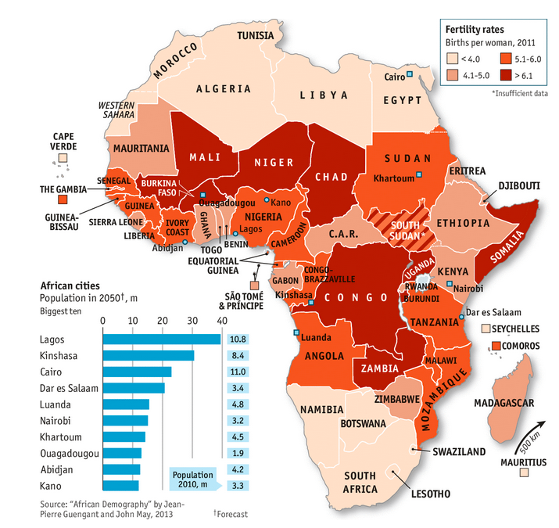
Population Growth Trends
Source: “African Demography” by Jean-Pierre Guengant and John May, 2013

Slide 25
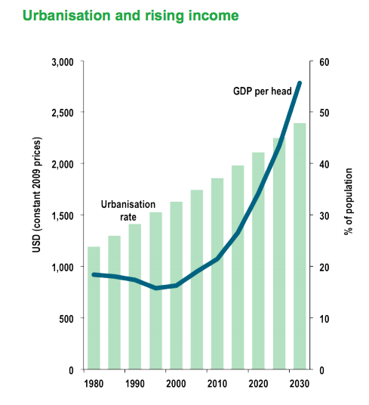
Urbanisation and rising income
GDP per head
Urbanisation
rate
USD (constant 2009 prices)
% of population
Source: IMF WEO Sept 11

Slide 26
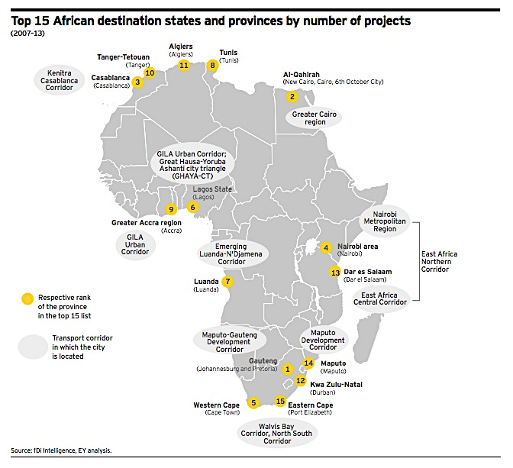
Urban Clusters & Key Hub Developments

Slide 27
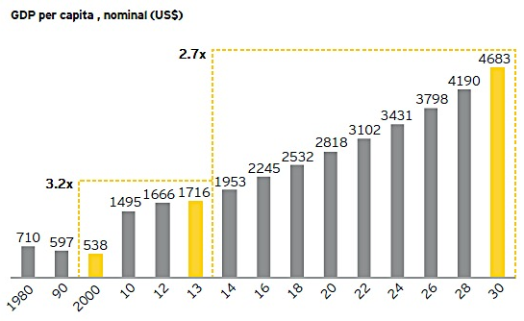
The Rise of Per-Capita Income
Source: World Bank, forecast from Oxford Economies Database

Slide 28
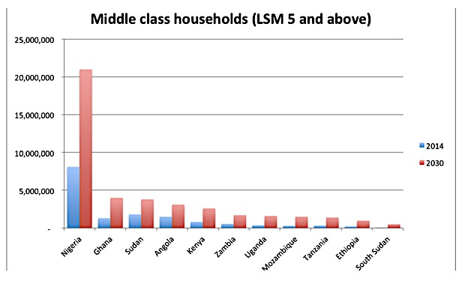
The Rise of the African Middle Class
Source: Unicef 2015

Slide 29
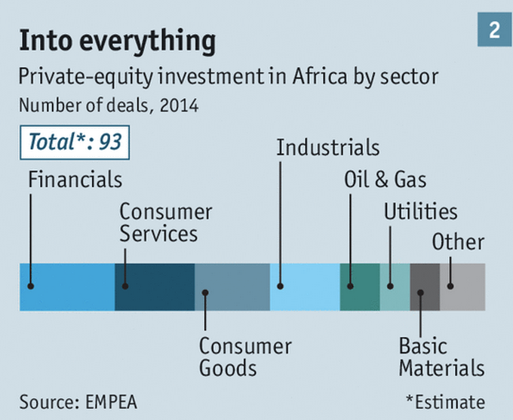
Consumer Services on the Rise

Slide 30
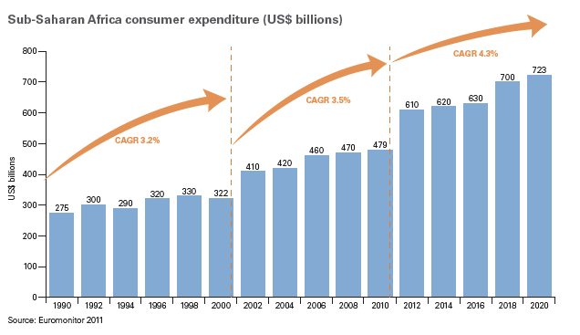
The African Consumer is Alive & Well..and Growing!

Slide 31
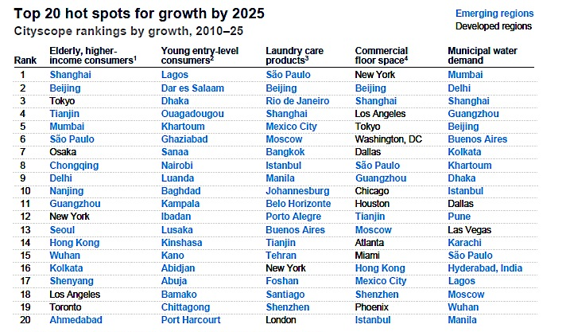
Cities of the Future: 2025 Growth Spots
Source: McKinsey 2012

Slide 32
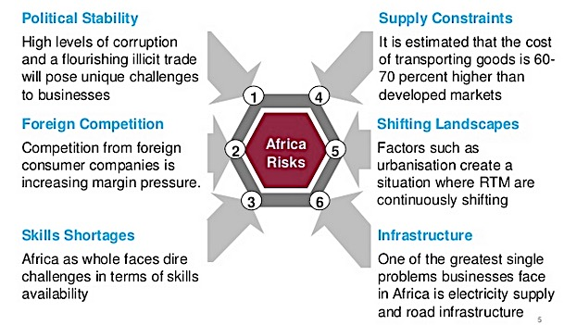
Not without its risks!

Slide 33
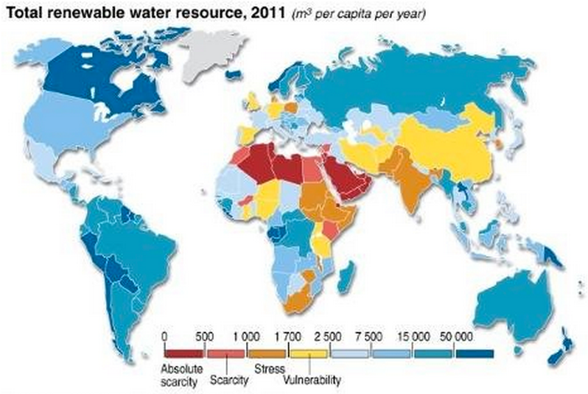
Competing demands for water and energy
Rising consumption of water power production threatens to create conflict
over freshwater supplies unless alternative to fossil-fuel energy are found.
Source: UN World Water Development Report 2014

Slide 34
THANK YOU
www.danielsilke.com

